Slide 1
Netflix Data Analysis
Data Analytics Internship Project
Unified Mentor Internship Program
Chandana Mala Veeranki

Slide 2
Project Objective
To explore and analyze Netflix movies and TV shows data.
To understand content distribution based on type, country, and release year.
To visualize trends in Netflix content using Python data analysis tools.

Slide 3
Dataset Information
The dataset contains information about Netflix movies and TV shows available on the platform.
It includes details such as Title, Type (Movie or TV Show), Director, Country, Release Year, Rating, and Duration.
The dataset is used to analyze content distribution and trends across different categories.

Slide 4
Tools Used
Python
Pandas for data cleaning and analysis
Matplotlib and Seaborn for data visualization
Jupyter Notebook for exploratory data analysis

Slide 5
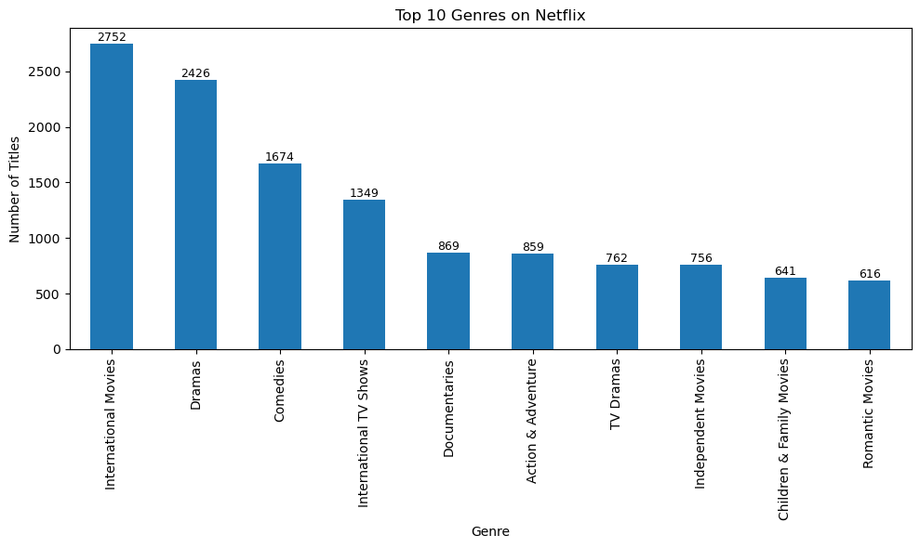
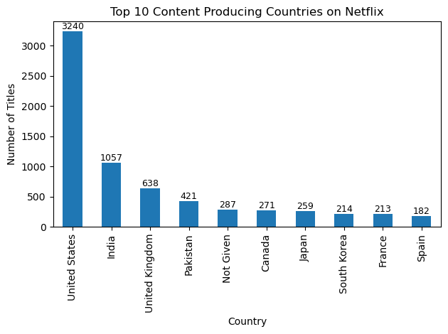
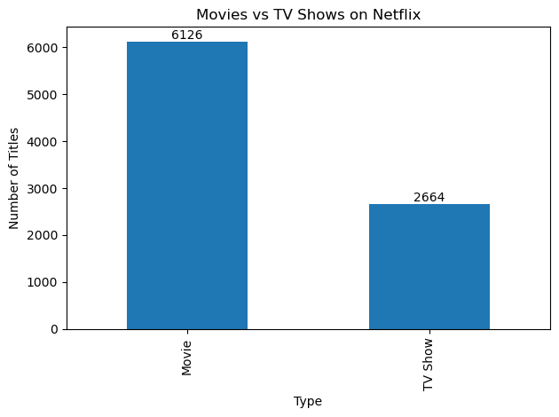
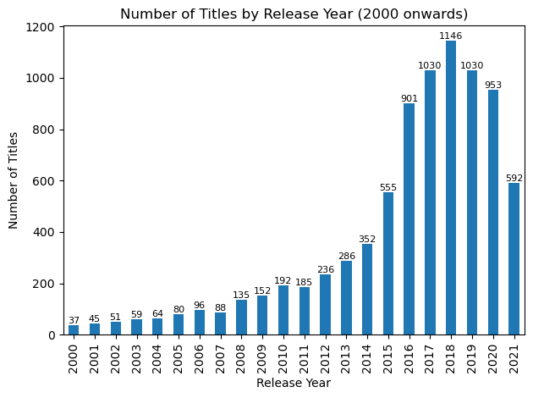
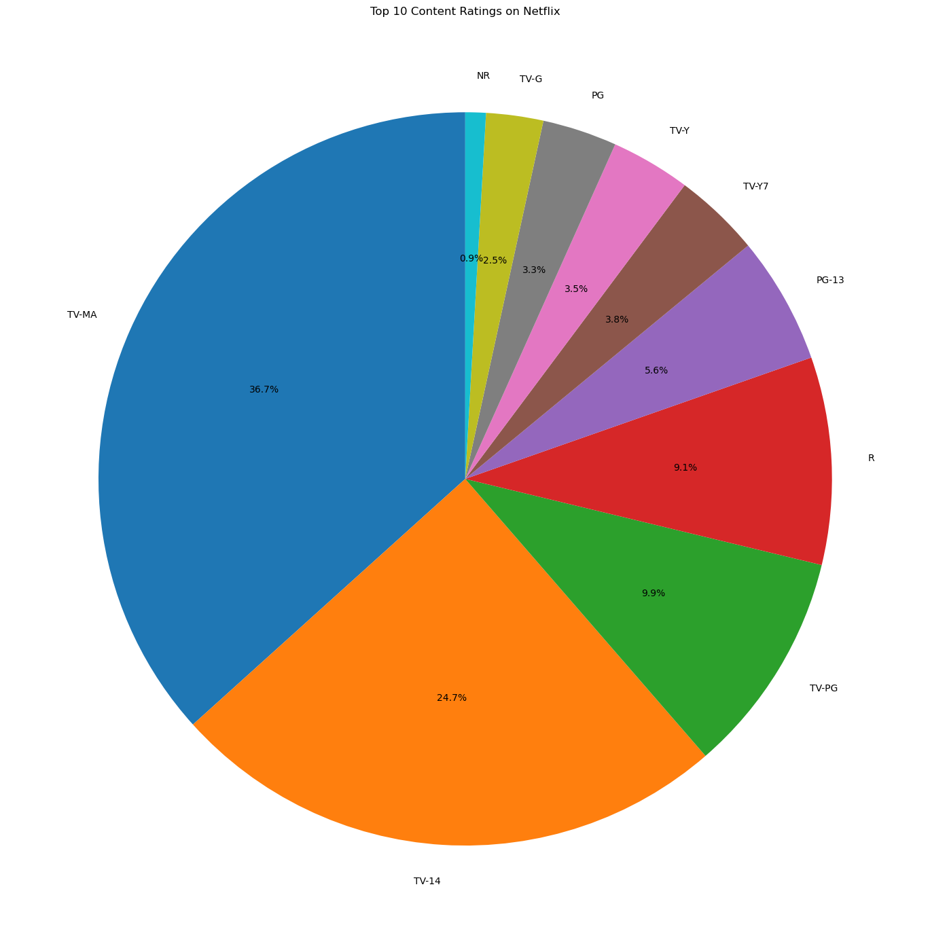
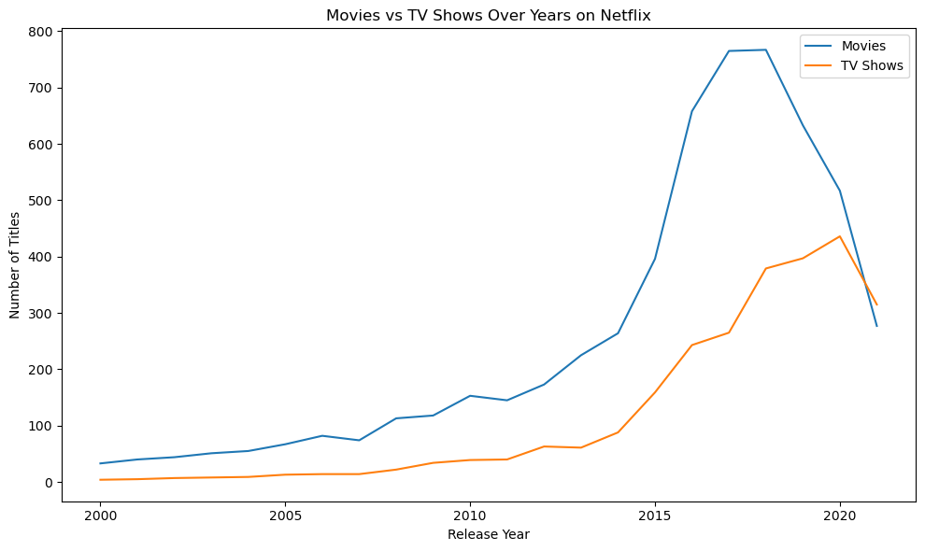
Data Visualizations

Slide 6
Key Insights
International Movies and Dramas are the most common genres on Netflix.
The United States produces the highest amount of Netflix content.
Movies significantly outnumber TV shows on the platform.
Netflix content increased rapidly after 2015.
TV shows have also grown steadily over recent years.

